Slide 1
The "Why? What? And How?" of Bit Coins
A crypto currency
Vivek Singh

Slide 2
Topics for today
Why should I know about BitCoins ?
What is BitCoin ?
What can I do with BitCoins ?
How to use BitCoins ?

Slide 3
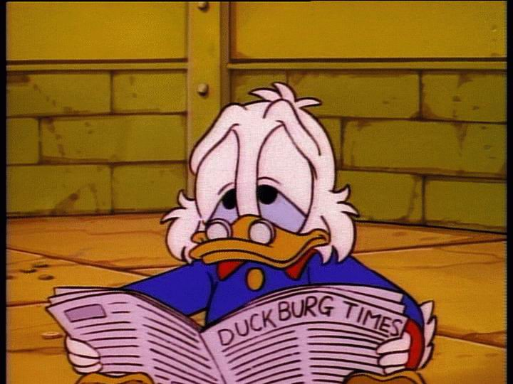
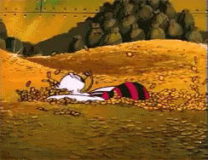
A short story
Bought at
$0.15 / bitcoin
Sold at
$800 / bitcoin
Invested : $3000
Total profit $691,981,901.91.

Slide 4
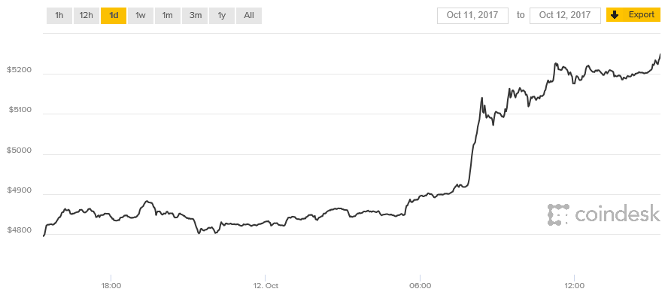
Today
October 12, 2017
October 10, 2017
$4778 / bitcoin
$5215 /bitcoin
Profit : $400 in 2 days
https://www.coindesk.com/price/

Slide 5
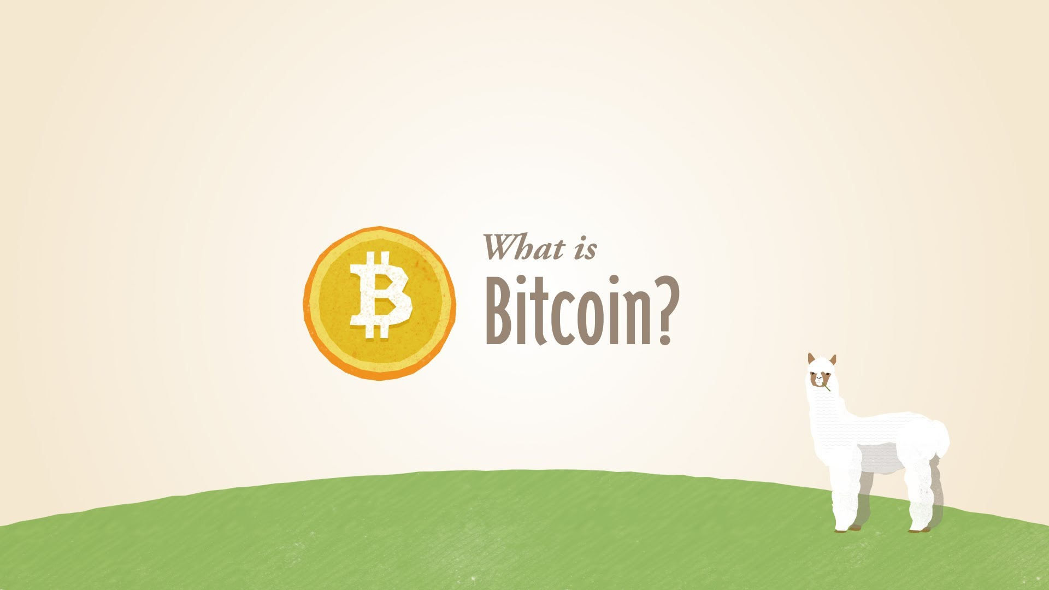
What is a bitcoin

Slide 6
A software currency
Bits
+
Coin
=
BitCoin
Something digital
Something related to currency
A digital currency

Slide 7
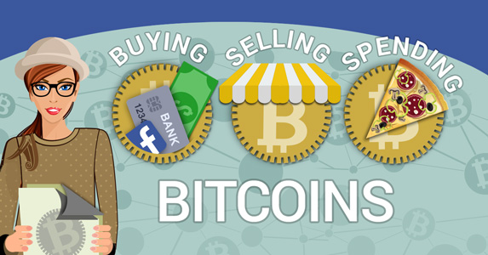
Digital Currency
=

Slide 8
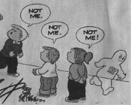
Who created BitCoin ?
No one knows ;)
Satoshi Nakamoto

Slide 9
Anonymous ? Why is it so valued
Why is the green paper in your wallet valued ?

Slide 10
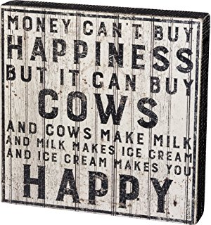
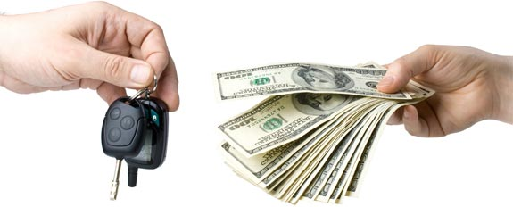
Why do you believe that a colorful piece of paper can get you an Ice cream, a cup of coffee , a car , or a mansion.

Slide 11
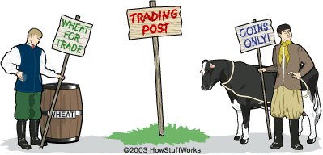
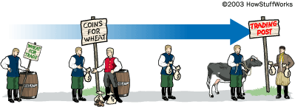
Its all about trust
I wish I had a cow
I wish I had some wheat
Coins/currency is something that everyone accepts as a medium of exchange
I TRUST COINS
I TRUST COINS

Slide 12
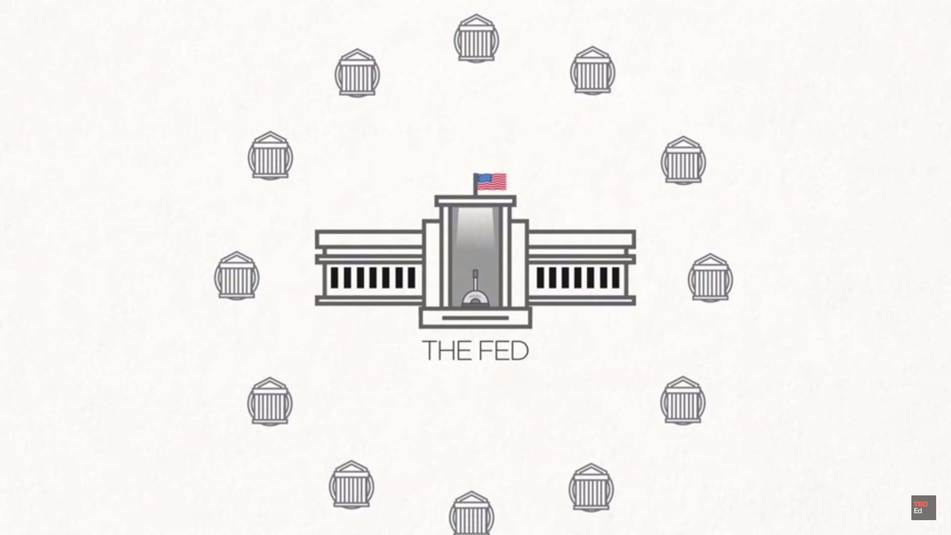
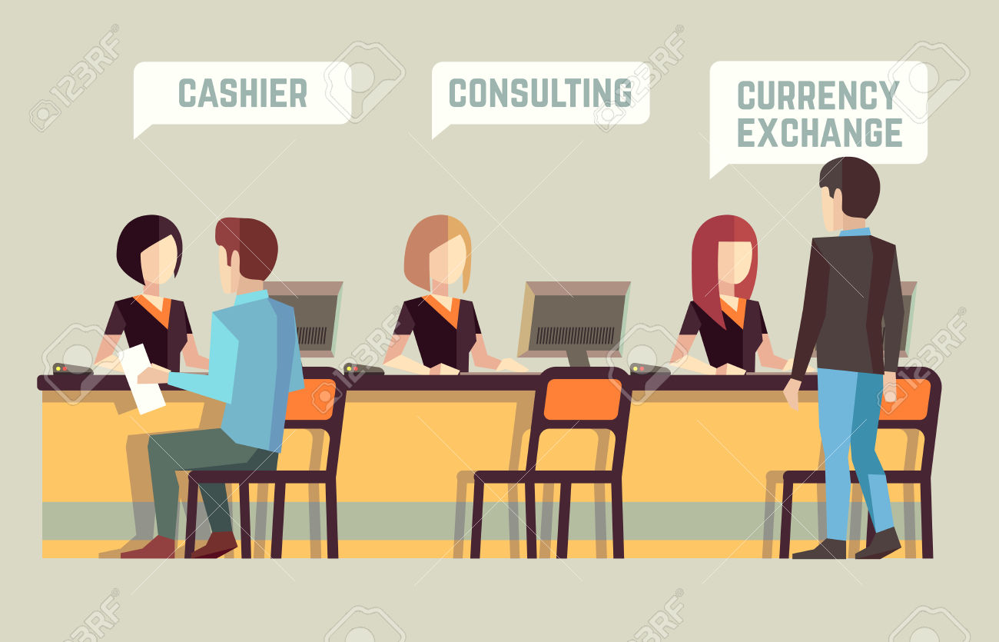
Who maintains the amount / validity / value of currency in the system
In the US it’s the FED and 12 regional banks.
Intermediaries

Slide 13
Real world vs Digital world
☺ Trust
☺ Cash flow
☺ Bank Transactions
☺ Regulation
BitCoin BlockChain
Algorithm

Slide 14
Problem with existing system
You pay to Intermediaries for exchanging/ transferring /storing your money
Fake currencies exist
It is prone to inflation
Government can stop you from receiving money. "Remember Wikileaks"

Slide 15
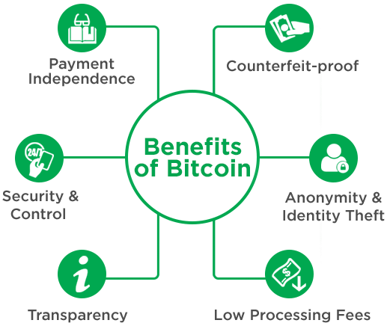
BitCoin BlockChain Algorithm takes care of it.

Slide 16
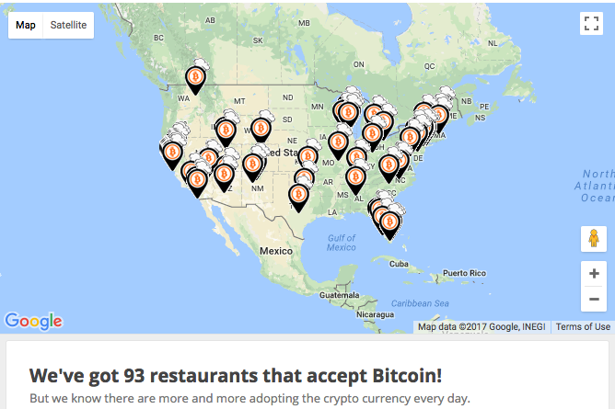
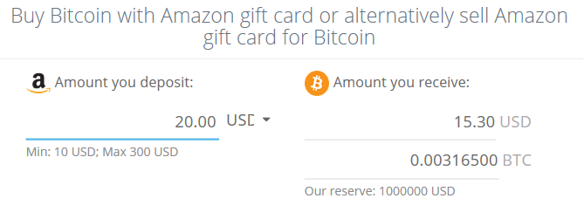
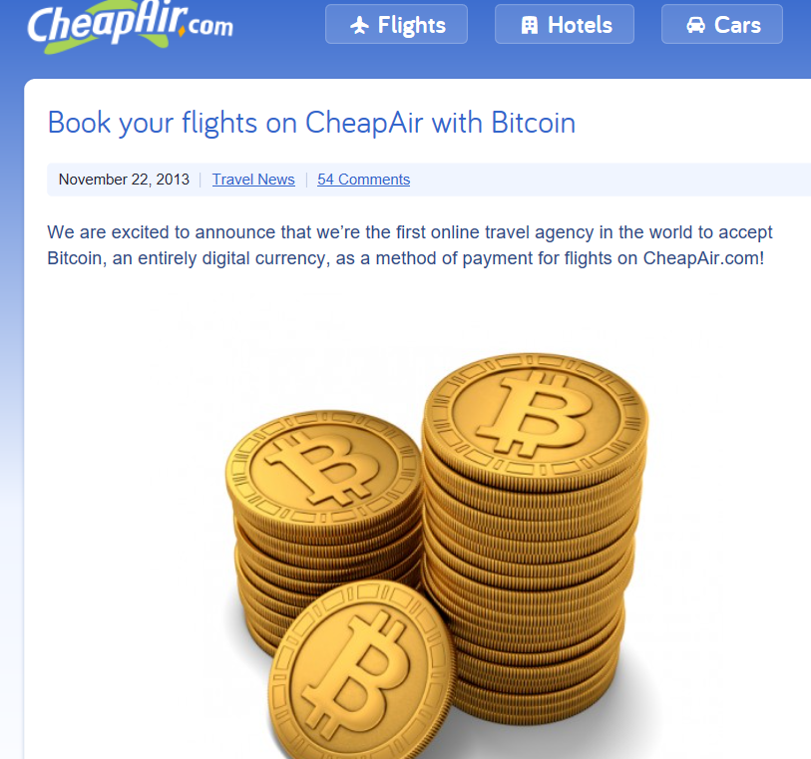
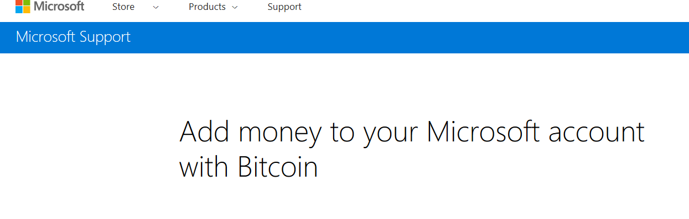
Enough :/ Where can I use it ?

Slide 17
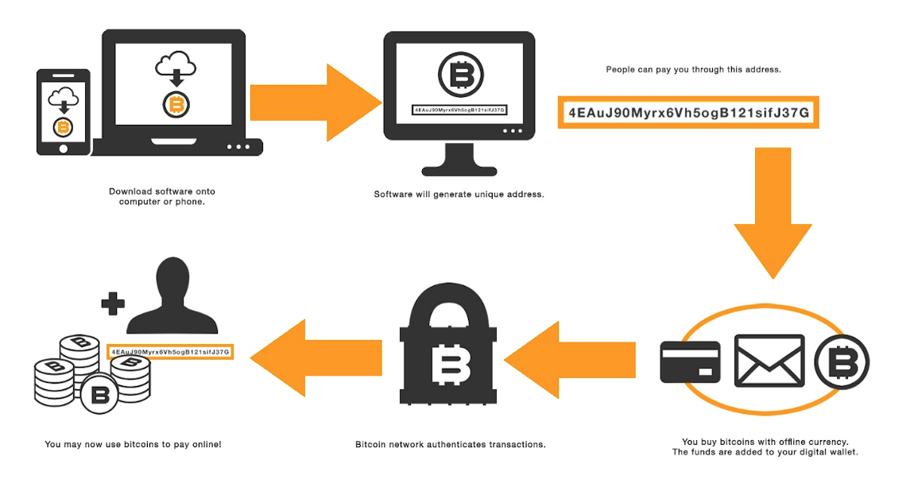
Cool! I also want some bitcoins..Where do I start ?

Slide 18
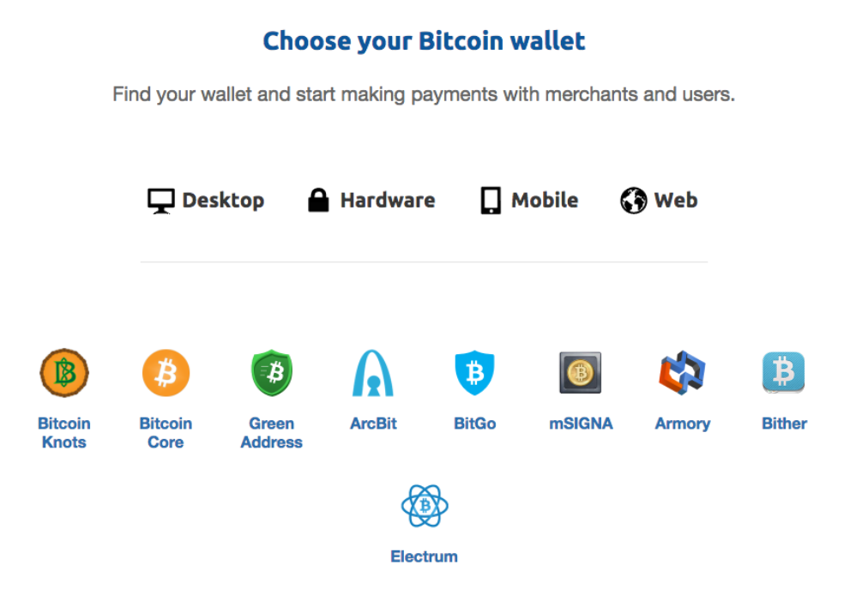

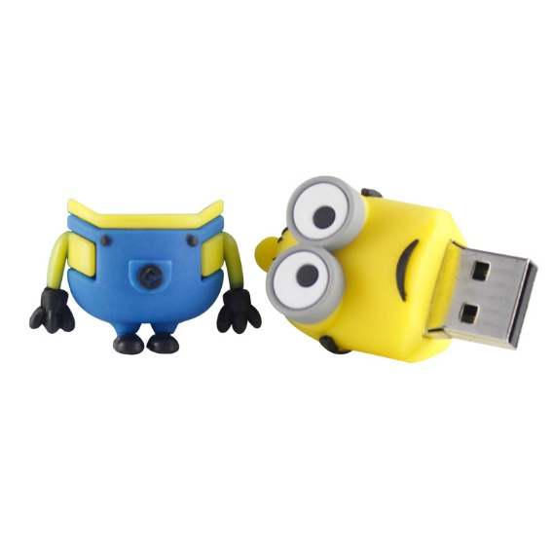
STEP 1: Download a bitcoin wallet https://bitcoin.org/en/choose-your-wallet
http://bitcoindaily.org/bitcoin-guides/bitcoin-core-tutorial/

Slide 19
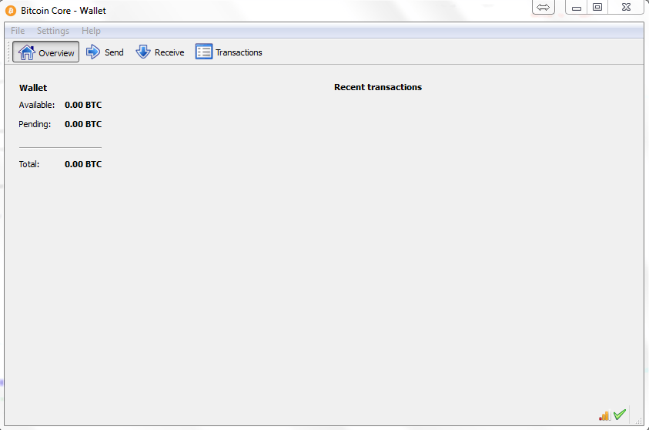
Bitcoin Core Wallet

Slide 20
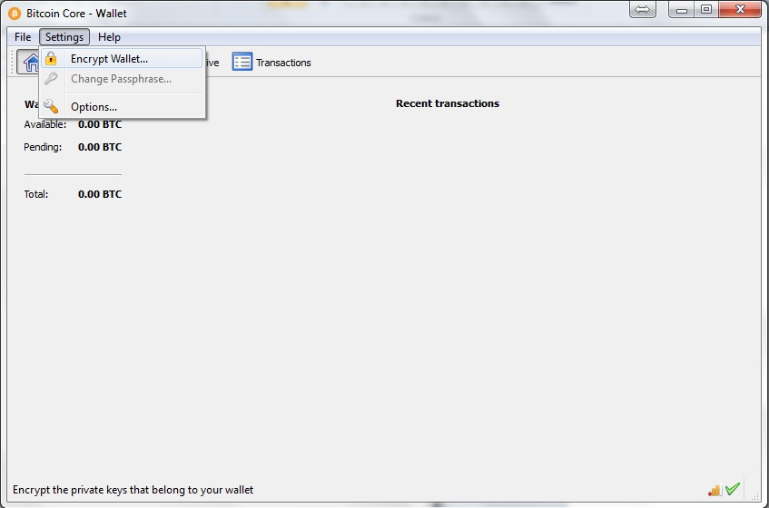
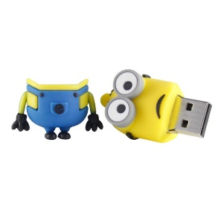
Bitcoin Core Wallet
Encrypt & Backup
Your wallet file (wallet.dat)
stores the data for
all of your public
& private keys

Slide 21
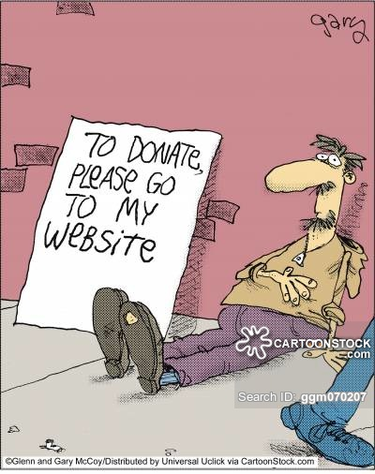
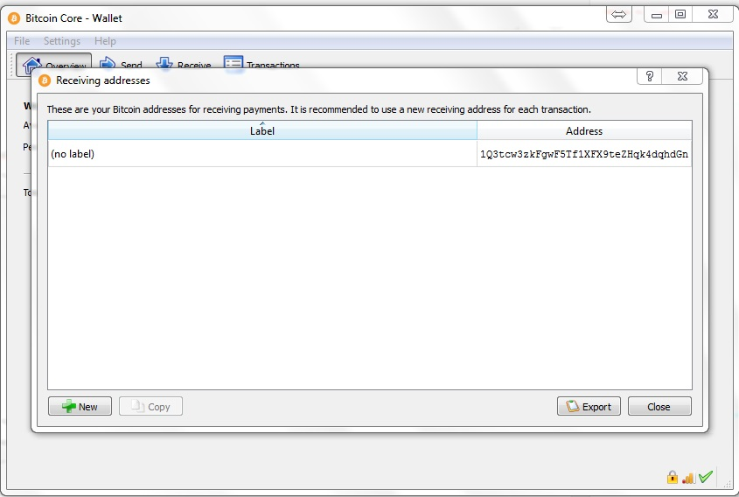
Bitcoin Core Wallet
Address (public key) : 1Q3tcw3zkFgwF5Tf1XFX9teZHqk4dqhdGn

Slide 22
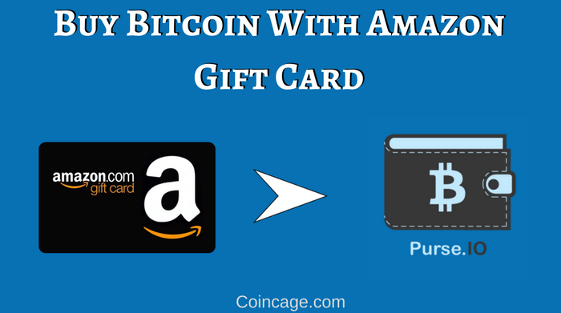
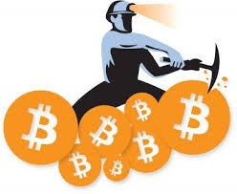
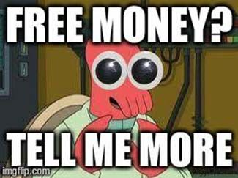
Step 2: Put Some Bitcoin in Your Wallet?
Convert Amazon gift card to Bitcoin
Receive Bitcoin from someone.
Buy Bitcoin directly from an exchange
Popular Bitcoin Exchanges
Bitfinex
Coinbase
Cryptsy
MineIT

Slide 23
Tell me more
1 ) Exchanges : Go to https://bitcoin.org/en/exchanges and find the one for your location
Beware of scam websites that are listed here: https://bitcointalk.org/index.php?topic=1326821.0 and http://www.badbitcoin.org/
Type in the exchange’s name in the following website to research for feedback,
positive and negative: reddit.com/r/Bitcoin and reddit.com/r/Bitcoinmarkets
2) Register to an exchange and get your account verified first.
3) Set up account security: 2 factor authentication
4) Deposit your currency and buy Bitcoin
5) Withdraw your Bitcoin after your purchase
Tansfer it to your hardware wallet (most secure : trezor) or software wallet (Bitoincore..)

Slide 24

Another story. Not to scare you
Mt. Gox was a bitcoin exchange based in Shibuya, Tokyo, Japan
In 2014 it was handling over 70% of all bitcoin transactions worldwide
In February 2014, Mt. Gox suspended trading, closed its website and exchange service,
and filed for bankruptcy protection from creditors. In April 2014,
the company began liquidation proceedings.
Mt. Gox announced that approximately 850,000 bitcoins belonging
to customers and the company were missing and likely stolen, an amount valued at more than $450 million
So, Withdraw your Bitcoin after your purchase

Slide 25
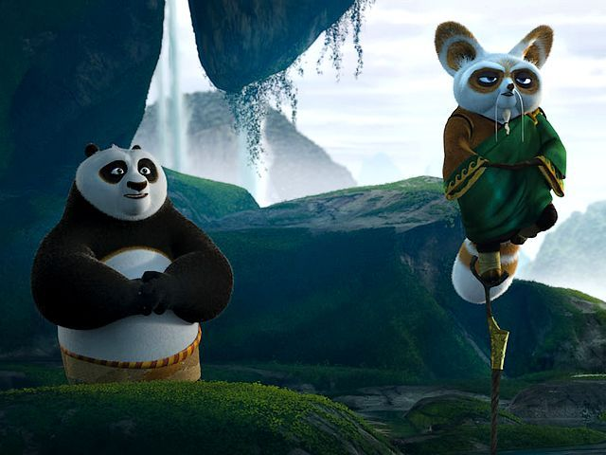
Piece of advice
1 ) Only use exchanges listed on https://bitcoin.org/en/exchanges
2 ) Research a bit on reditt before using any exchange
3 ) Bitcoin market is fragile, proceed with caution, its like stock market
4 ) Keep a backup of your private key, and keep your keys secure, free from hack

Slide 26
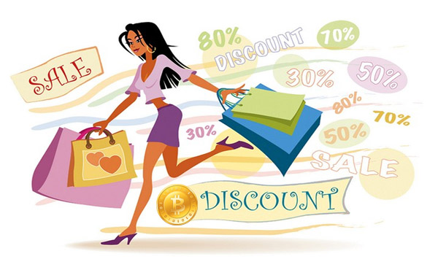
Step 3: Start Using Bitcoin

Slide 27
References / Acknowledgments
Google for Images.
https://medium.com/@viveksingh.heritage/bitcoin-for-beginners-answering-the-why-what-and-how-4e53a8b95bb6
https://medium.com/@CoinMeteor/how-to-set-up-the-bitcoin-core-wallet-client-for-beginners-and-send-your-first-transaction-819c6d5b9790
https://medium.com/@CoinMeteor/how-to-buy-bitcoin-wallet-basics-and-security-a-guide-for-beginners-6a3331972d3c
http://bitcoindaily.org/bitcoin-guides/bitcoin-core-tutorial/
https://blog.newegg.com/the-fastest-way-to-get-started-with-bitcoin/

Slide 28

Ask Questions if still awake ;)
Try buying some bitcoins
Register yourself at http://gsa.buffalo.edu/csc/

